Slide 1
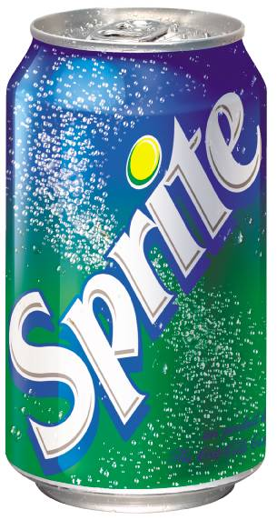
What does this drink have to do with Scratch?

Slide 2
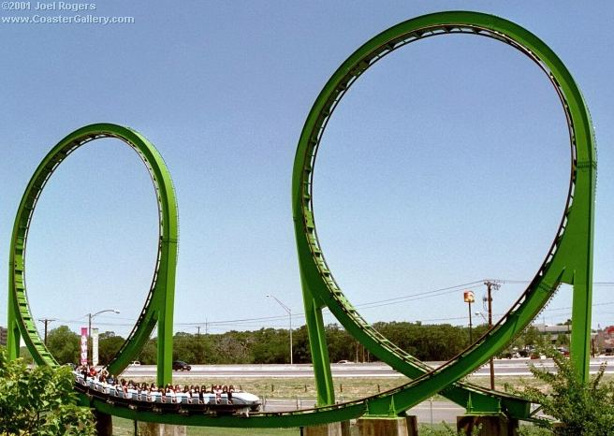
How is this related to Scratch?

Slide 3

Explain the connection to Scratch

